Slide 1
My Continuing Mission to Replace Myself with a Small Script
Python Continuingmission.py
Notes:
My continuing mission to replace myself with a very small shell script - except it probably won’t be small and it will probably be in Python.

Slide 2
Contents
esedbxtract – A script to extract password hashes from NTDS.dit and SYSTEM files.
GPPPFinder – Group Policy Preference Password Finder
Nettynum (v3) – A Windows Domain Enumeration Tool

Slide 3
Esedbxtract
Extract hashes from NTDS.dit and SYSTEM files from domain controllers.
Wrapper script around libesedb’s esedbexport, bundles ntdsxtract 1.2 and a modified dshashes.py
Handles all the fiddly details like datatable and link_table name changing depending on the version of Windows.
Outputs pwdump format
Notes:
Esedbxtract – Python script to extract domain password hashes from ntds.dit and system files of domain controllers.
I’m sure everyone knows about this – use vssadmin to create a shadow copy and of the domain controller’s partition that contains Active Directory (usually C but doesn’t have to be.), then use esedbexport to get the datatable and link_table, then use dshashes.py to extract the password hashes.
This script is basically a wrapper around that process to that you can just give it the ntds.dit and system files and it will output a pwdump formatted file with the domain password hashes.
Esedbexport is called as an asynchronous subprocess so that you can see the status messages and know that it hasn’t just hung, it can take a very long time to export the tables using esedbexport depending on the size of the Active Directory.
I had to modify dshashes.py to work with the latest version of ntdsxtract (a requirement function parameter was added), while I was doing I made it an object, so that it was easy to include in the overall script.

Slide 4
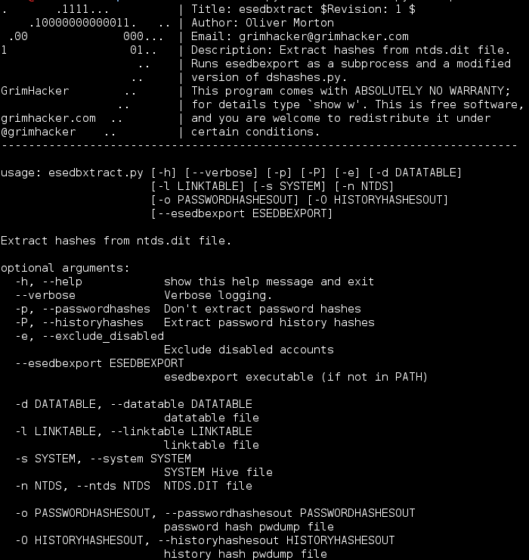

Slide 5
A short Aside – Get-PasswordFile.ps1
Getting the NTDS.dit and SYSTEM using Powershell.
Can’t just issue the same commands as you can from cmd.exe – the copy fails.
I’ve found a powershell script online! Not available on the original author’s site, so its in the quickscripts repo.
Either change the execution policy on the host to allow execution, or just copy the contents of the file into a powershell prompt then call the function:
Get-PasswordFile C:\
Notes:
Powershell is becoming more and more popular because its such a powerful administrative tool.
However it behaves a bit strangely when you try and copy the ntds.dit and SYSTEM files from a shadow copy – as in it fails completely.
I’ve found a powershell script online which defines a new powershell function to extract the ntds.dit and system files from a domain controller or the sam and system files from non-domain controllers.
By default powershell doesn’t allow scripts to execute, you can change that policy if you want, but its probably better to just copy the contents of the script into a powershell prompt and then call the function. That way the function only lasts for the powershell session and you aren’t making changes to security policies.
Since its no longer available on the author’s website (it looks like they have updated their blog and not ported the old articles), I’ve put a copy of it in the quickscripts repo on area51.

Slide 6
GPPPFinder – Group Policy Preference Password Finder
Introduced by Microsoft in Windows Server 2008
Policy Settings are enforced, Policy preferences are not.
Local Groups and User Accounts, Drive Mappings, Schedule Tasks, Services, and Data Sources – May have usernames and passwords.
Stored within the preference item in SYSVOL in the GPO containing that preference item.
MS14-025 (13th May 2014) Removed the ability to create new preferences with credentials in them. But doesn’t remove existing preferences.

Slide 7
GPPPFinder
Password is UTF-16 encoded string padded so that the length is a multiple of 16 (padding is chr of amount of padding required) then encrypted with a publically known key.
After encryption the password is base64 encoded and the “=” padding stripped.
Existing Tools:
Get-GPPPassword (PowerShell - http://obscuresecurity.blogspot.co.uk/2012/05/gpp-password-retrieval-with-powershell.html)
gpp (Metasploit Post Module - http://www.rapid7.com/db/modules/post/windows/gather/credentials/gpp)
gpprefdecrypt.py (Python - http://esec-pentest.sogeti.com/public/files/gpprefdecrypt.py)
gpp-decrypt-string.rb (Ruby - http://carnal0wnage.attackresearch.com/2012/10/group-policy-preferences-and-getting.html)

Slide 8
GPPPFinder
New Tool:
Connects to Domain Controller using specified credentials.
Searches recursively for XML files
Searches XML files for ‘password’
Parses XML of known files (e.g. groups.xml)
Outputs a file containing - username:cpassword:password:file
Cross Platform (sudo on linux because of mount command)

Slide 9
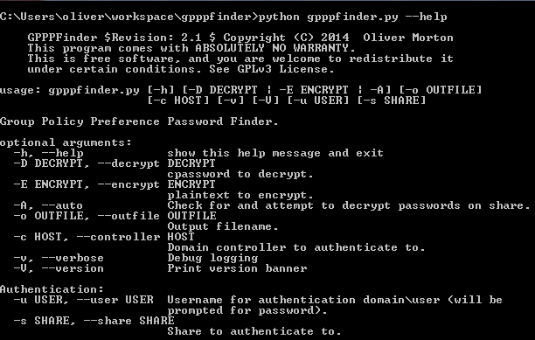

Slide 11
Nettynum Version 3
History – v1 (Placement Year), v2 (complete rewrite for final year project, unit testing, design documents, etc), v3 (LDAP)
Windows Domain Enumeration with minimum in put from tester – finds domain and domain controllers, extracts information, writes output file.
Uses Windows API calls and Null session by default (will wrap around rpcclient or net commands on linux… eventually…). Iterates through discovered domain controllers until it finds one will null sessions.
With credentials it will default to LDAP enumeration
Handles Sessions
Notes:
Nettynum is another project that I started on my placement year. It was initially a way for me to learn python while doing and try and make my life easier in the process.
I completely rewrote it and did all the background research, design documentation, unit testing etc for my final year project.
The current version is the continuing development of my university project where I am adding the features that uni wouldn’t let me put in because it would make it too big. Primarily this is using LDAP as another method of enumerating information and making it run on Linux based operating systems.
The purpose of nettynum is to automate the enumeration of information from a Windows domain with the absolute minimum of input from the tester.
Ideally you’ll just run the script and receive the output full of useful information. This is the case where null sessions are enabled, nettynum will use a variety of methods including using the Windows API and sockets to find the domain names on the network, then for each domain it will use a variety of methods including DNS lookups, the Windows API to find the domain controllers. It will then use the Windows API to create a null session to the domain controller and query for information such as the accounts policy, groups, group members, users, user account information (including whether it is locked out, how many bad password attempts has been made, the account comment).
If you are using null credentials it will iterate through the list of domain controllers it has discovered until it finds one with null sessions enabled or it runs out of domain controllers to try (I had this on a test last month - out of the 3 domain controllers only 1 had null sessions.)
Unfortunately (for us) null sessions are starting to become a bit rarer so we need to specify credentials to get information. If you specify a username and password then by default nettynum will attempt to use LDAP searches to gather the information once the domain controller has been identified. More information is available from LDAP which is why it used in preference over the Windows API – it is also easily cross platform which makes my life easier.
It supports both NetBIOS and DNS style domain names and chooses appropriate enumeration methods based on what it finds or what you provide.
Authentication using the Windows API (essentially the net use command) will first check if a session already exists, if it does it will use that and leave it in place after it has finished. Otherwise it will handle all the authentication for you. I’ve also built in so that it does not keep creating and destroying the session per enumeration, but authenticates when required and does not deauthenticate until it is sure the authentication will not be used again.
By default nettynum will find domain names, domain controllers, a full group list with comments, the accounts policy (lockout and the like), the members of groups match a supplied regular expression or a list of groups, (by default the regular expression picks up any group with admin in the name), and the user account information for each of those members.
The code is object orientated with polymorphism and abstracted such that I hope it can be reused easily when required.
I’m also working on local enumeration, but to be honest this has taken a bit of a back seat at the minute, so I’m not entirely sure how well that works. I plan to add multithreading so that lots of hosts are enumerated at once. And it will enumerate the same kind of information as the domain enumeration (groups, users, policies) along with active sessions (which I think may be useful to find domain administrator sessions…) and share information (similar to sharecheck).
When using the automated enumeration you can specify one or more pieces of targeting information in order to cut out some of the enumeration, for example if you already know the domain name and domain controller you can specify this and then let it do the rest.
For when the automated mode isn’t enough you can also use nettynum to retrieve specific information based on your input. For example say you want to know who is in the Unrestricted Web Access group, you can supply the group name, domain name and controller and specifically direct nettynum to get the members of that group.
Nettynum outputs an XML document as a report which can be opened in a web browser and viewed as a HTML webpage because I’ve used an XML stylesheet.
If you don’t like the way the output is displayed in the browser you can replace the style sheet without making any changes to nettynum itself.
I think this format is easy to read for a person in a web browser, but the XML makes it easy for other scripts to parse the output and use it.

Slide 12
Nettynum
By default it will find:
domain names
domain controllers
full group list with comments
accounts policy
the members of groups that match regular expression or a list of groups
the user account information for each of those members.

Slide 17
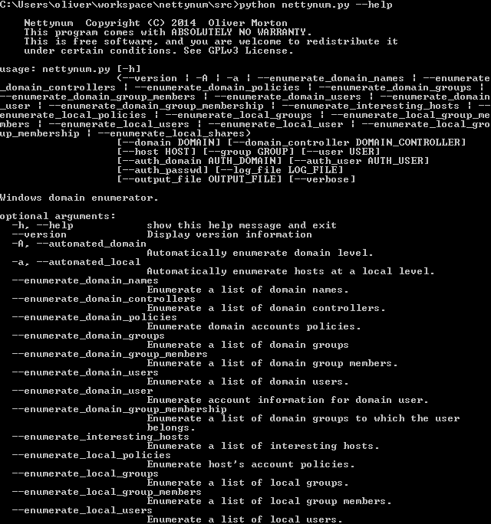
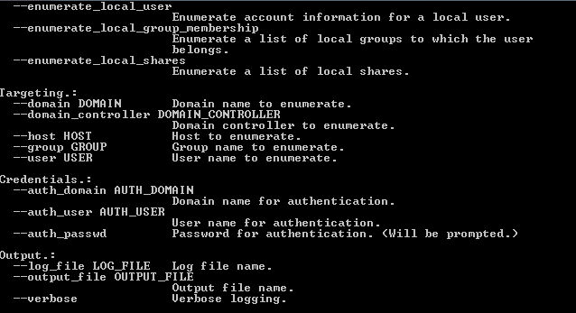
DON’T PANIC

Slide 18
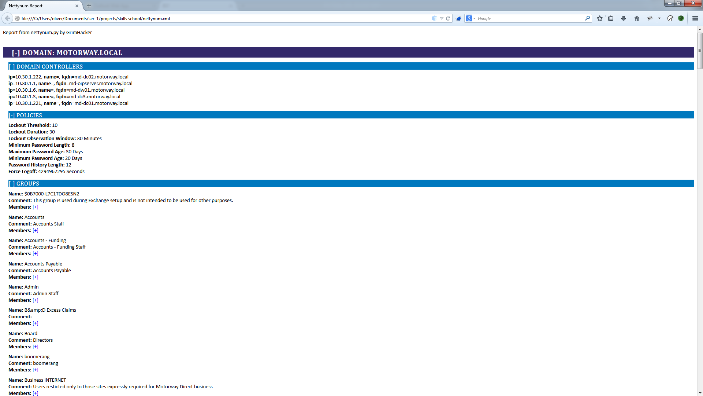

Slide 19
Questions?
Where to get them:
esedbxtract - https://bitbucket.org/grimhacker/esedbxtract
GPPPFinder - https://bitbucket.org/grimhacker/gpppfinder
Nettynum - https://bitbucket.org/grimhacker/nettynum
Notes:
They are all in git repo’s.
WigleMap is on area51.
Esedbxtract and nettynum are on my bitbucket.
If you don’t like the awesome convenience of git clone, you can also download them as zip files from there.

