Slide 1
An Introduction to Kerberos abuse
Oliver Morton
@Grimhacker
Notes:
I’m going to talk about some Kerberos abuse because it’s the default authentication protocol in Windows and therefore it shouldn’t be ignored just because it’s a bit complicated.
This is a pretty big area, every time I thought I was getting to the bottom of it I found another blogpost with reference to another area which I needed to look into…. I’ve therefore called this an introduction, because even thought I’m going to touch on 10 different issues, I’m sure there is more.

Slide 2
Part 0: Kerberos Primer
Notes:
I’m going to be talking about Kerberos in the context of Windows, so I’m sorry if you’ve read the RFC and know that I’m not always using the exact term, but the Windows equivalent – that’s because I know the Windows Domain better than the Kerberos Realm so its easier for me to remember and is more relevant in context.
This is also a really broad topic and I’m not going to be able to cover everything, who knows maybe I’ll deliver a part 2 of this talk some day with some more information and techniques.
None of this is original research, and all of it has been out there for a while, but I hope you’ll learn something anyway.

Slide 3
Kerberos Primer

Slide 4
Kerberos Primer
Key Distribution Center (KDC) aka Domain Controller (DC)
Session Keys
Long Term Keys
Security Principle: User on Workstation
Untrusted network
Security Principle: Service on Server
Tickets containing Session Keys
Notes:
A quick primer for Kerberos.
Its an authentication protocol that came out of MIT and is name after the three headed dog Cerberus in Greek mythology. That name is apt because there are 3 parties in Kerberos authentication: the client who wants to authenticate, the resource server that the client wants to authenticate to, and a 3rd party the key distribution center who both the client and server trust.
Kerberos has built in security features such as encryption, antireplay, and optionally mutual authentication. Its also designed to run over an untrusted network – hence my little avatar in the middle of the network.
The key distribution center is on the Windows domain controller (in the top right), the client user on their workstation on the left, the resource server (in the bottom right)
The authentication is all within a Kerberos realms, which in Windows is the Domains. One important point is that the you need to use the DNS style domain name for Kerberos, not the netbios style, and a bit of a gotcha with a lot of tools is that you have to specify it in all caps.
Technically the key distribution center is made up of the authentication server and ticket granting server, but on Windows this is all just the domain controller, so I’m not going to worry about it.
Kerberos uses several different keys. Long term keys which are derived from the user or resource account password, and session keys which are created for encryption of communications for each session.
A core concept within Kerberos is “tickets”, these are made up of two parts a bit you can decrypt and a bit you can’t. The bit you can decrypt contains, amongst other things, the session key to use with the resource service, and you can decrypt it because its encrypted with your long term key. The bit you can’t decrypt also contains the session key, but its encrypted with the resource service’s long term key.

Slide 5
Kerberos Primer
AS_REQ (request TGT)
KRB_ERR (Preauth required)
AS_REQ (request TGT)
AS_REP (receive TGT)
Optional PAC validation Request/Response
TGS_REQ (present TGT, request TGS)
TGS_REP (TGS response)
AS_REQ (present TGS)
AS_REP (optional, for mutual authentication)
Notes:
So lets step through the authentication process:
The user on their workstation wants to connect to the file server service on the remote server.
0a) The user sends their username to the KDC and requests a ticket.
0b) The KDC responds with an error demanding that the user authenticates themselves first. This is for backwards compatibility. Pre authentication being required is the default in Windows, and in fact all of Kerberos v5. However in v4 it wasn’t – but we’ll come onto that in a few minutes.
1a. Password converted to encryption key (for RC4-HMAC this is the NTLM hash default for XP and 2003, for Vista and above an AES key is used by default), a timestamp is encrypted with the user’s key and sent to the KDC as an authenticator in the authentication ticket (TGT) request (AS-REQ).
1b. The Domain Controller (KDC) checks user information (logon restrictions, group membership, etc), generates a session key for use between the user and itself, and creates Ticket-Granting Ticket (TGT), encrypting the session key with the user’s long term key and its own long term key.
2. The TGT is encrypted, signed, & delivered to the user (AS-REP). Only the Kerberos service (KRBTGT) in the domain can open and read TGT data.
3. The User presents the TGT to the DC when requesting a Ticket Granting Service (TGS) ticket (TGS-REQ). The DC opens the TGT & validates PAC checksum – If the DC can open the ticket & the checksum check out, TGT = valid. The data in the TGT is effectively copied to create the TGS ticket.
4. The TGS is encrypted using the target service accounts’ long term key and sent to the user (TGS-REP).
5.The user connects to the server hosting the service on the appropriate port & presents the TGS (AP-REQ). The service opens the TGS ticket using its NTLM password hash.
6. If mutual authentication is required by the client (think MS15-011: the Group Policy patch from February that added UNC hardening).
Unless PAC validation is required (rare), the service accepts all data in the TGS ticket with no communication to the DC.

Slide 6
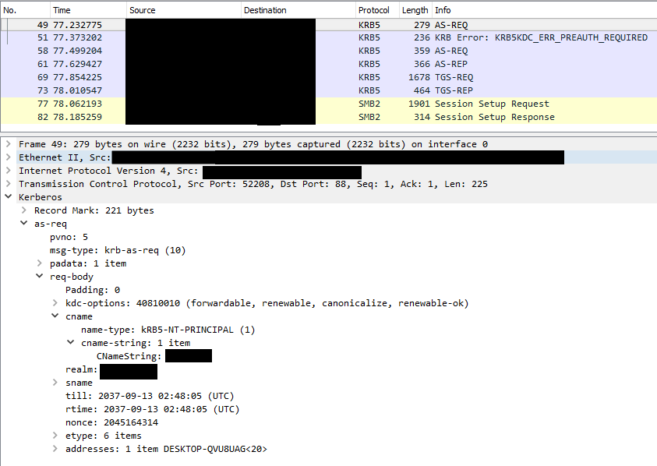
Notes:
Lets have a quick look at that as a packet capture.
So first we send the AS-REQ with the Kerberos realm (domain name) and our username to the KDC (domain controller)

Slide 7
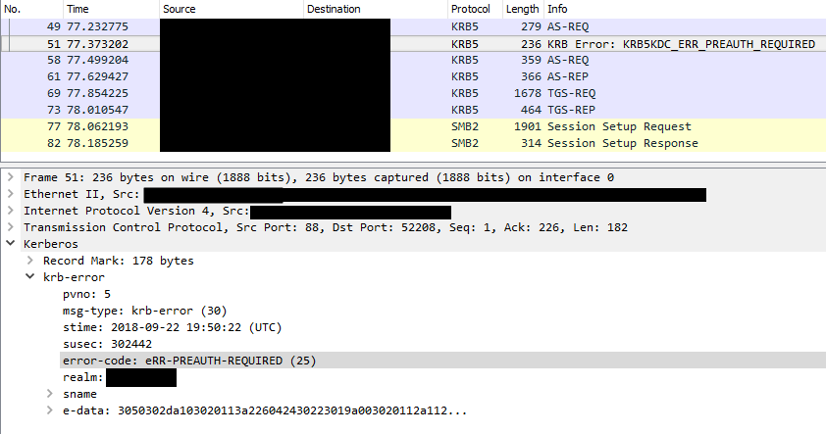
Notes:
Then we receive the error from the domain controller stating pre authentication is required for the user.

Slide 8
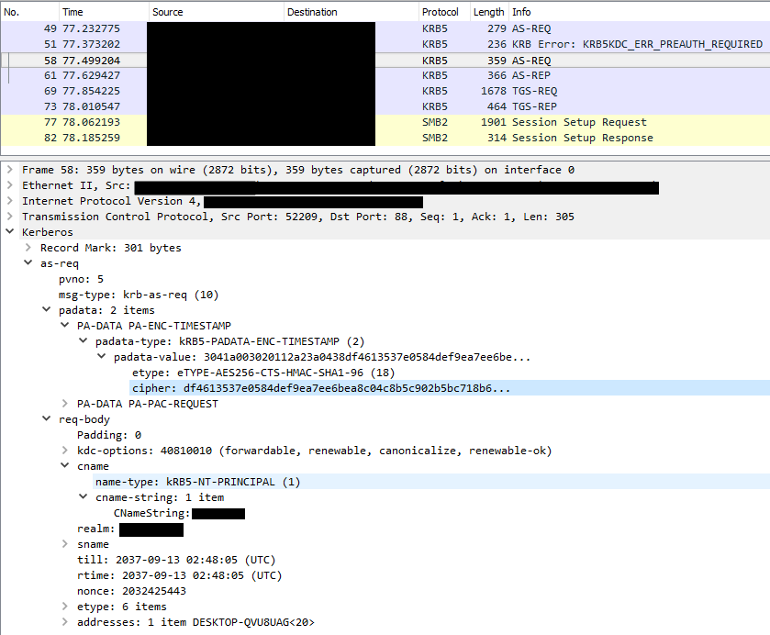
Notes:
Next we send another AS-REQ with a timestamp encrypted with the user’s key.
This use of timestamps is the reason why time accurate time is important in Kerberos – if you are having problems and seeing SKEW errors, its probably because your machine’s time is more than 5 minutes out from the domain controller’s time. (that 5 minutes can be configured, but I highly doubt any administrator is going to bother unless it’s a regulatory requirement in hardened environments….

Slide 9
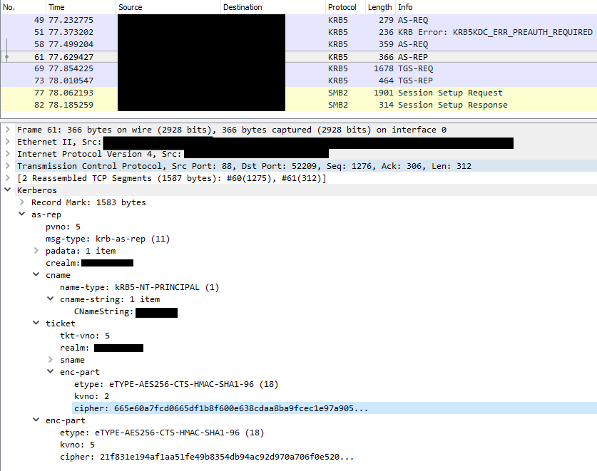
Notes:
Since we have used the correct password for the user account, the KDC has been able to decrypt the timestamp using the key stored in its database so has validated that they are communicating with the legitimate user.
They respond with a ticket granting ticket. This has the session key for communicating with the KDC encrypted with both the user’s key and the Kerberos service key. By default this is valid for 10 hours and can be renewed within that time up to a maximum of 7days.

Slide 10
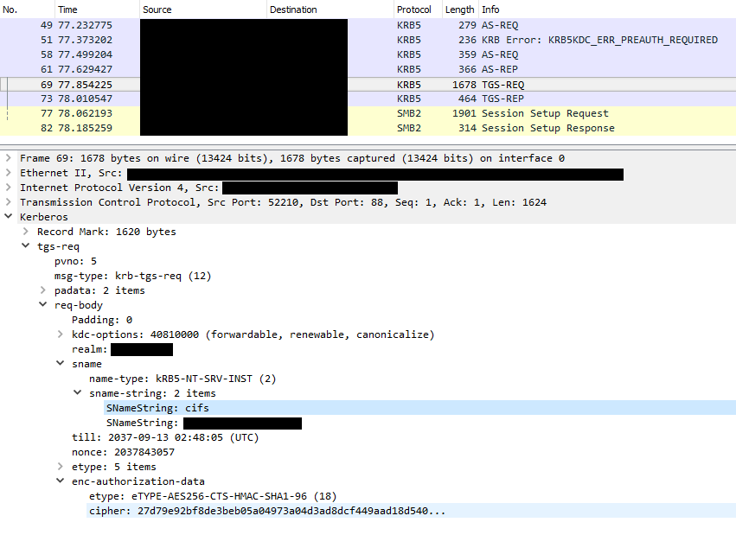
Notes:
Next we send another request to the KDC with our TGT ticket and request access to the CIFS service on the remote server.

Slide 11
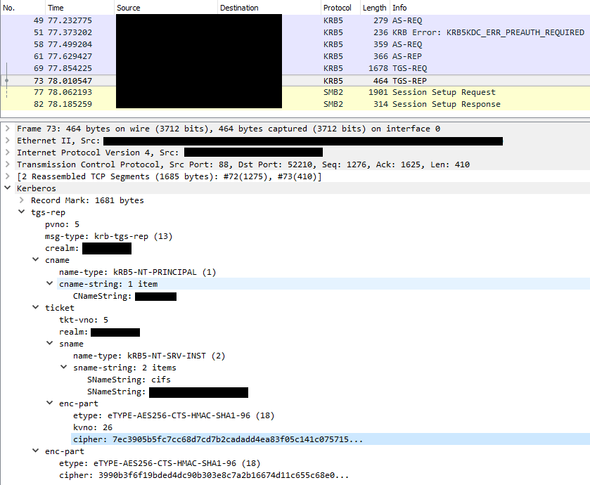
Notes:
The KDC generates a session key for use by the user and the service, and encrypts it with the user’s key and the service’s key, packages it up in a ticket and sends it back to the user.

Slide 12
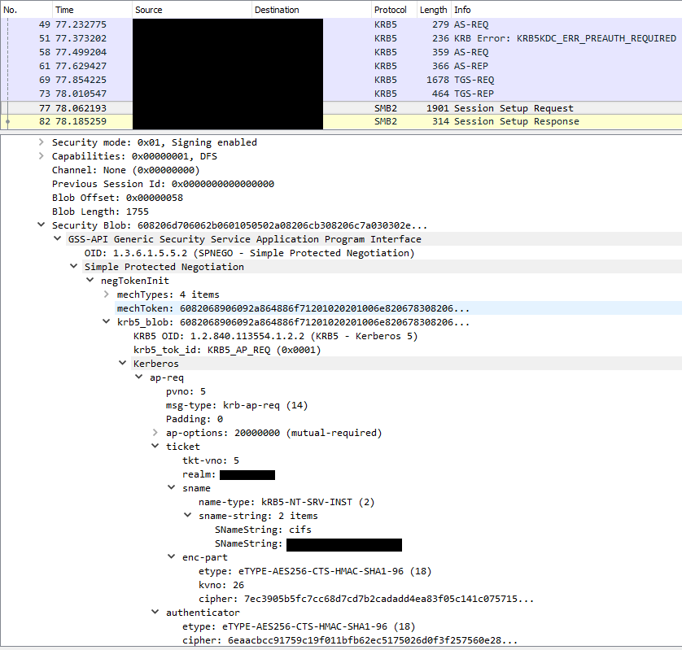
Notes:
The user then presents the service ticket to the service, in this case in an SMB Session Setup Request.
Since the service is able to decrypt its half of the ticket it trusts that the user is who they say they are because only the KDC would be able to encrypt the session key for the service – because only the service and the KDC know the service’s key.
So the service response checks its own configuration to see if this user is authorized to access the service, and response appropriately.
That’s another interesting point to note, the KDC is not responsible for authorization, just authentication. The KDC validates and you are who you say you are, but its still down to the service to determine if you are allowed to use the service.

Slide 13
Eugh….! Boring! Get to the point!
….Pretty diagrams….
…Packet Captures…
….Rambling walkthrough….
*yawn* when’s the next coffee break?
Notes:
So I trust you were all captivated by walkthrough of a successful Kerberos interaction between a legitimate user, the KDC, and a service.
Sorry about that, but understanding those steps is kind of important to understanding what we can do at each step of that process for our benefit….
So without further ado, here are some more packet captures.

Slide 14
Part 1: Username Enumeration

Slide 15
Username Enumeration
AS_REQ (request TGT)
KRB_ERR (Preauth required)
Notes:
That very first interaction with the KDC can be used for username enumeration, completely unauthenticated.

Slide 16
What happens if we present an invalid username?
Notes:
If we present an invalid username in that initial Authentication Service Request, we receive the error Principal Unknown. Where as a valid username will error requiring pre-authentication, stating the account is disabled or locked out.
So this is a pretty classic example of a username enumeration issue. Send a valid username get one response, send an invalid username get an error. While many, including Microsoft, don’t consider username enumeration to be a vulnerability in itself, personally I find being able to identify valid usernames to target for password guessing or other attacks to be quite handy.

Slide 17
Notes:
You may be aware that I’m a big fan of automating all the things.
So instead of sending candidate usernames through net use commands and searching through packet captures, I thought it would be good to have a tool that did this…
Luckily for my limited free time, a few tools already exist to do this.

Slide 18
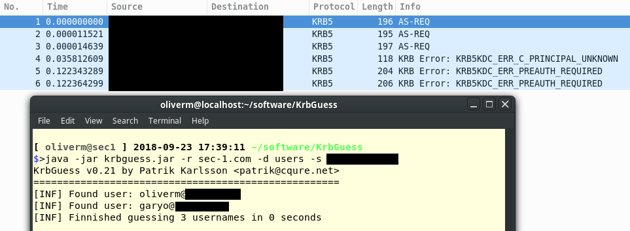
Username Enumeration
KRBGuess.jar (https://www.cqure.net/wp/tools/password-recovery/krbguess/)

Slide 19
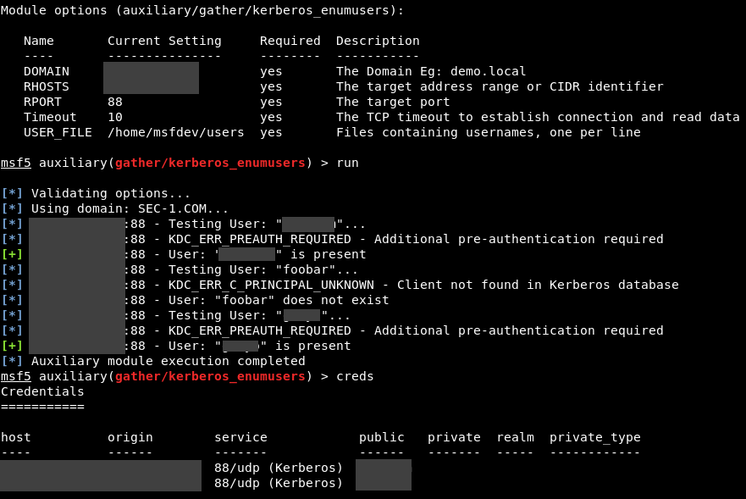
Username Enumeration
Metasploit

Slide 20
Username Enumeration: Defense
There is no “fix” for this…
Detection:
Multiple PRINCIPLE_UNKNOWN errors
Notes:
There is no fix for this since its just how the protocol works.
However you might want to consider detecting when a machine is rapidly sending out AS-REQ packets that result in PRINCIPAL UNKNOWN since that is likely to indicate someone is trying to enumerate valid usernames, and getting a bunch wrong.

Slide 21
Part 2: Intercepting AS-REQ

Slide 22
Intercepting AS-REQ
AS_REQ (request TGT)
KRB_ERR (Preauth required)
AS_REQ (request TGT)
AS_REP (receive TGT)
Notes:
Little bit further along in the process.
Remember I said that Kerberos is running over an untrusted network? Well there I am, completely untrustworthy and listening for all of the Kerberos messages flying by.

Slide 23
Intercept AS-REQ
Passively sniff the network
Identify AS-REQ traffic
Attempt to decrypt the ciphertext with potential passwords
When the decrypted data looks like a timestamp you have identified the password.
Key is NTLM hash for systems up to and including: XP and 2003
Vista and above does not use NTLM by default, more difficult to crack, partly due to lack of support (https://github.com/hashcat/hashcat/issues/1386)
Notes:
If you can intercept AS_REQ requests you can subject them to an offline bruteforce attack. Attempt to decrypt the timestamp with possible passwords, when the decrypted data looks like a timestamp you’ve cracked it.
Key is NTLM hash for systems up to and including: XP and 2003
Vista and above does not use NTLM by default, more difficult to crack, partly due to lack of support (https://github.com/hashcat/hashcat/issues/1386)
Currently I don’t know of a tool that lets you do this easily, if anyone knows of or finds one, let me know :)

Slide 24
Intercept AS_REQ: Defense
Encourage strong passwords
Disable RC4-HMAC (Beware compatibility)
Limit the opportunities for MITM attacks?

Slide 25
Part 3: No Preauthentication Required

Slide 26
No Preauthentication Required
AS_REQ (request TGT)
AS_REP (receive TGT)

Slide 27
No Preauthentication Required
Preauthentication can be disabled for backwards compatibility with Kerberosv4
Part of the AS-REP response from the KDC is encrypted with the user’s long term key
Default is AES, however in the AS-REQ you can specify that you only support RC4-HMAC – i.e. use the NTLM hash of the user’s password
Offline bruteforce of AS-REP to recover the user’s password.

Slide 28
No Preauthentication Required
Identify accounts with an LDAP filter: (userAccountControl:1.2.840.113556.1.4.803:=4194304)
PowerView’s Get-DomainUser has a parameter –PreauthNotRequired (https://github.com/PowerShellMafia/PowerSploit/blob/445f7b2510c4553dcd9451bc4daccb20c8e67cbb/Recon/PowerView.ps1)
ASREPRoast (http://www.harmj0y.net/blog/activedirectory/roasting-as-reps/)
Kerberos Party Tricks (http://www.exumbraops.com/blog/2016/6/1/kerberos-party-tricks-weaponizing-kerberos-protocol-flaws)
Notes:
You can identify vulnerable accounts if you already have authentication using an LDAP filter.
Powerview has this implemented as well if that’s you thing.
But usually when I’m trying this I don’t have credentials yet, so using ASREPROAST from HarmJ0y is the way to go. You can iterate through usernames and it will print out the hash if the account is vulnerable. You need to custom compile john with a modified format that HarmJ0y has provided, but other than that it should work pretty well. No support in hashcat yet – but there is an open issue if anyone wants to contribute.
Or if you wanted to go old school you could use the Kerberos party tricks script from Geoff Janjua at Exumbraops. This is the script I have successfully used in the past to pull out an AS-REP for a vulnerable use and crack it. But it’s a bit of a flaky tool and as I recall I had to fiddle with the code a bit to get it to work…

Slide 29
No Preauthentication Required: Defense
If at all possible always require preauthentication
If preauthentication MUST be disabled: Ridiculously complex account password

Slide 30
PArt 4: Kerbroasting

Slide 31
Kerbroasting
Kerberos in Windows uses Service Principle Names (SPN) to determine which account key to use to encrypt the service ticket.
“host-based” SPN’s are linked to a domain computer account
“arbitrary” SPN’s are usually linked to a Domain User account
<MSSQLSvc/mssql1.testdomain.com:1433>
When the user requests a TGS for the service, the KDC will encrypt the session key with the user’s long term key AND the service account’s long term key.
Notes:
Service Principle Names are used to determine which account key is used to encrypt a service ticket.
There are two types, host-based linked to a domain computer account and therefore of little value to us since the computer account password is long and random so we are going to have a hard time cracking it; and arbitrary which are usually linked to user accounts and therefore much more interesting since as we all know, user accounts often have horrible passwords on them, particularly if it’s a user account being used as a service account – someone set that password a long time ago and no one will want to change it in case it breaks something….
A service running on a server in the network often needs to be able to authenticate to resources within the domain, the legacy way to do this is to configure a domain user account for the service to run as. Configuring this involves setting up SPNs on that account for the service, for example an account configured for an MSSQL service to run as might have an SPN like this: MSSQLSvc/mssql1.testdomain.com:1433
When the user requests a TGS for this SPN, the KDC will lookup which account the SPN is registered to, generate a session key, and generate a service ticket containing the key encrypted with the service account’s long term key. This gives us some material we can subject to an offline bruteforce attack in order to recover the service account password.
A cool thing about these SPNs is that the service doesn’t need to be accessible, available, or even exist for us to exploit the SPN. This configuration is on the KDC and the interaction I’m about to talk about is only between the client (in this case the attacker) and the KDC.

Slide 32
kERBROASTING
AS_REQ (request TGT)
KRB_ERR (Preauth required)
AS_REQ (request TGT)
AS_REP (receive TGT)
TGS_REQ (present TGT, request TGS)
TGS_REP (TGS response)

Slide 33
Kerbroasting
Old School:
“
Enumerate the domain accounts with SPNs set- either with Tim’s GetUserSPNS.ps1 script, Sean’s Find-PSServiceAccounts.ps1 script, or PowerView’s “Get-NetUser -SPN“.
Request TGSs for these specific SPNs with the builtin Windows tool setspn.exe or the .NET System.IdentityModel.Tokens.KerberosRequestorSecurityToken class in PowerShell.
Extract these tickets from memory by invoking the kerberos::list /export Mimikatz command , with the optional base64 export format set first. The tickets were then downloaded, or the base64-encoded versions pulled down to the attacker’s machine and decoded.
Begin offline password cracking with Tim’s tgsrepcrack.py, or extract a crackable hash format from the raw ticket with John the Ripper’s kirbi2john.py.
“
https://www.harmj0y.net/blog/powershell/kerberoasting-without-mimikatz/
Notes:
The old school process to accomplish kerbroasting is described by harj0y on his blog.
Essentially, identify the accounts, request the TGS for the SPN’s using setspn.exe or a powershell script, use mimikatz to extract the tickets from member, convert the mimikatz output to a format john can process and get cracking.
I’ve copy pasted the section from Harmj0y’s blog because luckily I was late to the party so this process was made a lot nicer by the time I heard of it.
Interesting point to note here though is that you can extract Kerberos tickets from memory using mimikatz… its not just for pulling out clear text passwords… but I’ll come back to this later.

Slide 34
Kerbroasting
Impacket’s GetUserSPNs.py
Auxiliary/gather/get_user/spns (Metasploit wrapper around GetUserSPNs.py)
PyKerbroast (kerbroastv2.py)
PowerSploit’s Invoke-Kerberoast
Notes:
I’m not going to dwell too much on kerbroasting because its now a pretty much point and click process. You need valid user credentials, and any one of these tool (and there are probably others) in order to recover the encrypted material that you can then crack with John the Ripper or Hashcat.
This is a great way to escalate privileges within a domain, I’ve personally accessed domain administrator accounts using this technique. As with the AS-REP Roasting, you are reliant on your password cracking prowess and poor password selection.

Slide 35
Kerbroasting: Defense
Service account passwords > 25 characters
Managed Service Accounts / Group Managed Service Accounts (May require Functional Level Upgrade)
Detection:
Sean Metcalf (@PyroTek3) https://adsecurity.org/?p=3458
SPN Honeypot
Flag RC4-HMAC
Notes:
You can mitigate, but not prevent this attack by configuring service accounts with a password greater than 25 characters long, to reduce the probability of a successful bruteforce attack.
You could also implement managed service accounts, as this password is long and complex and rotated regularly and automatically.
Sean Metcalf has a blog post around detection of Kerbroasting which goes into a fair amount of detail.
But it comes down to monitoring Kerberos authentication events, sifting through them to flag suspicious ones such as those that only support RC4-HMAC, or setting up a honeypot SPN whereby you know that if anyone is requesting that SPN or logs into the account that SPN is registered to, something malicious is going on.

Slide 36
Part 5: MS14-068 Vulnerability in (Active Directory) Kerberos Could Allow Elevation of Privilege

Slide 37
MS14-068
TLDR from CERT:
The Microsoft Windows Kerberos KDC fails to properly check for valid signatures in the Privilege Attribute Certificate (PAC) included with the Kerberos ticket request. A domain user may forge the information contained in the PAC to request higher user privileges than should be allowed. Since the KDC does not verify the signature correctly, it will award the user the requested privileges, effectively making the user a domain administrator and allowing complete compromise of the entire domain.
Metasploit: Admin/Kerberos/ms14_068_Kerberos_checksum
Notes:
The Microsoft Windows Kerberos KDC fails to properly check for valid signatures in the Privilege Attribute Certificate (PAC) included with the Kerberos ticket request. A domain user may forge the information contained in the PAC to request higher user privileges than should be allowed. Since the KDC does not verify the signature correctly, it will award the user the requested privileges, effectively making the user a domain administrator and allowing complete compromise of the entire domain.
Originally there was a python tool called pyKEK which could be used to exploit this issue with some help from mimikatz, however now there is a Metasploit module which exports an MIT Kerberos Credential Cache file which you can use on Linux, or convert using mimikatz for Windows. Be warned that these tools always seem to respond positively even if the DC has been patched. Best off just trying it against each domain controller and hoping they haven’t patched in 4 years….

Slide 38
MS14-068
Setup Kerberos tools on Linux (krb-user / krb5-workstation)
configure a Realm in /etc/krb5.conf
create ticket (kinit username@DOMAIN_NAME.com)
copy the file from msf to /tmp/krb5cc_0
open a session (smbclient –W DOMAIN_NAME.COM –k //DC1.DOMAIN_NAME.COM/C$)
Mimikatz.exe “Kerberos::ptc file_from_msf.bin”
Psexec \\dc1.domain_name.com –s cmd.exe
Notes:
On linux you have to go through a few setup steps before you can use the forged ticket you created with Metasploit.
Install the dependency, confiure the realm to match the domain name and domain controller
Initialise a ticket with you user creds
Copy the file that Metasploit created you over the top of your actual ticket. Note that the zero on the end of that filename is you user id on your linux system, zero being root
You can then open a session to the domain controller using your forged ticket, since the ticket says you are in the domain admins group.
Windows is already setup to use Kerberos so you can import the ticket using mimikatz, and then use psexec to open a command prompt on the domain controller.

Slide 39
MS14-068: Defense
PATCH!

Slide 40
Apart: A quick word about credentials in Memory

Slide 41
A quick word about credentials in memory
Logging on Interactively to a computer leaves your credentials in memory on the target computer
Logging off *should* clear them, but they can be left orphaned in memory
Windows 8 and later wipe the plaintext password from memory (wdigest disabled)
KB2871997
“Protected Users” AD Security Group
No NTLM
No Digest auth
No CredSSP
Kerberos Ticket TTL reduced from 10HR to 4HR
No RC4/DES keys used for Kerberos
Notes:
Why traditionally there?
Why less so now (ms patch back ported)
protected user groups (impact on kerberos ticket life)
Logging on interactively leaves your credentials in memory, this applies if you login directly to the computer or over RDP.
Apparently just logging off should clear them from memory, but they can be left orphaned, so the only way to be sure is to nuke them from orbit by rebooting the machine.
Windows 8 and later wipe the plaintext password from memory there was also an update to backport this behavior – but it has to be enabled.
You’ll probably have noticed this on pentests if you have been using mimikatz, plaintext creds are just a bit harder to come by than they used to be.
you can fiddle with the registry and entice a user to login again, but I’m not a fan of messing with the registry I’m always just a bit to worried it will all go horrendously wrong and I’ll get kicked offsite for taking down their critical systems….and besides there is no guarantee that the same highly privileged user that we are targeting will login again…
Microsoft has also introduced the “Protected Users” group in Windows Server 2012 R2. Users in this group can’t use NTLM, digest authentication or CredSSP – making it even more unlikely that their credentials will be hanging around in memory. Also the TTL for the TGT is reduced from 10hours to 4 hours, and DES / RC4 keys will not be used.
So basically on modern systems you are much less likely to get plaintext creds or NTLM hashes from memory anymore, particularly if the Protected User group is in use.

Slide 42
Part 6: Abusing Tickets From Memory

Slide 43
Dumping Tickets from Memory
Requires admin access
mkdir outputdir; cd outputdir
Mimikatz.exe
Privilege::debug
Sekurlsa::tickets
Sekurlsa::tickets /export
Want ones with @krbtgt-DOMAIN.COM in the filename
Convert to kirbi to ccache
Kekeo.exe
Misc::convert ccache ‘filename@krbtgt-DOMAIN.COM.kirbi’
Notes:
So like all techniques for recovering credentials from memory we need administrator permissions
First off create clean directory to work in.
Trusty mimkatz is still the best tool for the job, run the correct version (32/64bit) and enter the command to enable debug privileges.
You can list all of the tickets and then export them in the kirbi format. This is going to export all of the Kerberos tickets currently on the system, and there can be LOTS of them, hence setting up the clean directory
The tickets that we really want are the TGT for the user these have got krgtgt and the domain name in the output filename.
Depending on if we are going to be abusing these tickets in Windows or Linux we might need to convert them. If you are on Windows then you can just take the kirbi file, if you are on linux then you’ll need to convert the kirbi file to the ccache format. You don’t need to do this conversion on the system that you found them on, any Windows system will do.

Slide 44
Cracking Dumped Tickets
…Sure… its encrypted with the user’s key which is derived from their password….
…But… why bother….?

Slide 45
Pass The Ticket
Dump the ticket
Crack the ticket to get the password for the user
Use the password to make a ticket
Use the ticket to authenticate to the domain…
….wait a minute…
Notes:
Kerberos is the default authentication on windows, so if you use the password you recover to login to a system you are going to be creating a Kerberos ticket to authenticate… but you already have the Kerberos ticket!
You have everything you need so no need to heat up the planet with your password cracking rig. You can just use the ticket.

Slide 46
Pass the Ticket
Use the ticket while its fresh!
Import it into your keychain, and your system will keep renewing it for you…
Windows:
In the session you want to add the ticket to… don’t need admin permissions
Mimikatz.exe
Kerberos::ptt TGT_FILE.kirbi
klist
Psexec \\dc1.domain.com cmd.exe
Notes:
One constraint of this is that the ticket has to be relatively fresh when you find it. Remember I said by default it has to be renewed every 10 hours, and every 4 hours for users in the Protected Users group, but did I mention that that renew is handled automatically by Windows up to that maximum renewal lifetime of 7 days?
So provided you haven’t recovered the ticket from an offline source, like a backup or something, you can just import the ticket into your keychain and use it, once its imported.
So how do we actually do this?
Well on Windows its relatively simple with the help of mimikatz, because as I’ve said before, Kerberos is already configured and running we just need to load the ticket in.
You can do this on any windows system in any session, you don’t need to be joined to the domain – your windows VM will work fine, you don’t need to be running from a command prompt, standard user will do:
Kerberos::ptt tgt_filename.kirbi
That’s it, you can then exit out of mimikatz, use the builtin klist windows command to check your stolen ticket is in the list, and then use it to open a command prompt on the domain controller using psexec.
Best to remember thought that this won’t work if you specify the remote host by IP address, you have to use the fully qualified domain name of the host or the ticket won’t be used. And make sure your time is synchronized to the domain controller – if you are more than 5 minutes out you might get an error.

Slide 47
Pass the Ticket
On Linux:
Setup Kerberos tools on Linux (krb-user / krb5-workstation)
configure a Realm in /etc/krb5.conf
copy ccache file from kekeo to /tmp/krb5cc_0
secretsdump.py –no-pass –k –outputfile secrets.txt DOMAIN.COM/USER@dc1.domain.com
Notes:
So this should look pretty familiar if you were paying attention earlier – setup Kerberos tools on linux, configure the realm, copy the ticket to the temporary file which the Kerberos service uses (remembering that last digit is your user id)
We can now use any tool that supports Kerberos authentication, for example secretsdump.py

Slide 48
Part 7: Over pass the Hash (AKA Pass The Key)

Slide 49
Over Pass The Hash
If RC4 is supported you can use the NTLM Hash to create a Kerberos TGT ticket.
Notes:
Not going to spend any time on this.
Overpass the hash is simply using the user’s NTLM hash to create a Kerberos ticket.. You can only do it if RC4 hasn’t been disabled. And frankly I don’t really see the point.

Slide 50
Part 8: Silver Ticket

Slide 51
Silver Ticket
Forged TGS Ticket
No interaction with the domain controller
Need service key (NTLM hash)
Attacker granted access to the service with the privileges they state they have
Optional PAC validation Request/Response
AS_REQ (present TGS)
AS_REP (optional, for mutual authentication)
Notes:
A Silver Ticket is a forged Ticket Granting Service Ticket.
Unlike the normal authentication there is absolutely no interaction with the domain controller, unless the service is configured to perform PAC validation (which is apparently rare) and there is to Ticket Granting Ticket.
In order to forge the TGS ticket you have to have the service’s long term key – or more accurately the key of the account the service is configured to run as, the one with the Service Principle Name. An current tools seem to need this to be the NTLM hash so that RC4 can be used.
The good thing about this attack is that you get whatever privileges you ask for within the context of the service. You group membership is held within the ticket, and so long as the service can decrypt it, it trusts that it has come from the KDC. So you can just configure the ticket to state you are a member of the domain admins group, and just like that you have domain admin privileges.
But bear in mind its only for that one service, and because you don’t have a ticket granting ticket you can’t access other services automatically, you need to make a forged TGS ticket for each service you want to interact with.
For actual attackers and red teaming that requires persistence, this can be a powerful and relatively stealth technique. If you have managed to get hold of the computer account password hash, you can use it to forge silver tickets for computer services such as CIFS and HOST, you can access the filesystem and execute commands.
For normal pentesting I don’t think this technique is going to be particularly helpful – but you never know what password hashes you are going to find hanging around in backups… so once in a blue moon it might be worth it.

Slide 52
Silver Ticket: Defence
Disable RC4 support / Monitor RC4
Notes:
From what I’ve seen the current tools require the NTLM hash in order to use RC4 to forge a ticket. Technically I imagine this could be done with AES keys as well if you have the account password, but at the minute the tool support doesn’t seem to be there, so it would raise the barrier to entry

Slide 53
Part 9: Golden Ticket

Slide 54
Golden Ticket
Optional PAC validation Request/Response
TGS_REQ (present TGT, request TGS)
TGS_REP (TGS response)
AS_REQ (present TGS)
AS_REP (optional, for mutual authentication)
Notes:
The golden ticket is another type of forged Kerberos ticket. This type we are forging a valid Ticket Granting Service Ticket. As you can see on the diagram the initial requests to validate the user are no longer required.
In order to forge the ticket we need to have the krbtgt (Kerberos account) key.
Using the Kerberos account hash, we can create a ticket for our user that states we are a member of the domain admins group, and that the ticket is valid for 10 years. Since the KDC can decrypt the ticket, it trusts that it (or another KDC) created the ticket, and grants access.
Therefore like the silver attack its only rarely going to be of use during a normal pentest.
However I have personally used this technique to compromise a domain – I found an old backup of a domain controller on a network share, every domain admin had since changed their password, but the Kerberos account hadn’t been changed, so I was able to create a golden ticket. It’s a good trick to keep in mind.

Slide 55
Golden Ticket: Defence
Protect the KRBTGT account key!
Prevent DA from logging onto any computer other than the DC
Protect your backups!
Regular change the KRBTGT account password
https://gallery.technet.microsoft.com/Reset-the-krbtgt-account-581a9e51
Detect based on RC4 usage / behavior analysis tools
… then engage some serious incident response…
Notes:
Protect the KRBTGT account key!
Prevent DA from logging onto any computer other than the DC, and delegate all other admin rights to other admin groups
Protect your backups!
Regular change the KRBTGT account password. You need to change it, wait a day for replication to complete, and then change it again, to purge both the current hash from the history – otherwise the old password can still be used. Microsoft have provided a script and guidance for this which must be read closely before doing this – if you get it wrong you are going to have the worst week of your life while you recover.

Slide 56
Part 10: Kerberos Delegation

Slide 57
Delegation
Giving an account the right to impersonate another account
Notes:
Kerberos delegation is giving an account the right to impersonate another account.
I can see absolutely no way that that could possible blow up in your face….
Constrained, unconstrained
Double hop…
Double hop. Delegation. Intermediary service (iis) can authenticate to another service (mssql) as the user. Can protect accounts to prevent this but not default. Find service with delegation, compromise that, impersonate da?

Slide 58
Delegation
User: Show me articles
Service: Select * from articles
Notes:
Delegation solves a problem in multi tiered applications sometimes referred to as the “Kerberos Double Hop Issue”. Traditionally when a user requests a resource from a front end server, the front end server will authenticate the user, then the front end server will use its service account credentials to access the back end server.
This isn’t great from an accountability perspective as all interaction between the front and backend server is as the front end service account rather than as the user, and the from a permissions perspective we are also granting rights to a service account sufficient for all users it may be serving, rather than granting those permissions to the user.

Slide 59
Delegation
Ticket for “User” please
You are “User” now…
User: Show me articles
User: Select * from articles
Notes:
However if we grant the service account on the front end server permission to impersonate the user, then it can request a ticket on behalf of the user and authenticate to the backend system in the context of the user.

Slide 60
Unconstrained Delegation
AS_REQ (request TGT)
KRB_ERR (Preauth required)
AS_REQ (request TGT)
AS_REP (receive TGT)
Optional PAC validation Request/Response
TGS_REQ (present TGT, request TGS)
TGS_REP (TGS response)
AS_REQ (present TGS)
AS_REP (optional, for mutual authentication)
Notes:
Just so you know, its not quite that simple….
The service doesn’t just get to request access as the user. Its got to already have the user’s TGT.
The way that works is that when the user requests a TGS for a service with unconstrained delegation rights the KDC will include the user’s TGT in the TGS, so that when the user sends the TGS to the front end service, it can decrypt the TGS and retrieve the TGT.
The TGT is then stored on the server for future use.

Slide 61
Unconstrained Delegation
“Trust this computer for delegation to any service (Kerberos only)”
1) Find a server running a service with unconstrained delegation rights:
Get-ADObject -LDAPFilter:"(&(objectCategory=computer)(objectClass=computer)(userAccountControl:1.2.840.113556.1.4.803:=524288))“
Get-ADObject -LDAPFilter:"(&(objectCategory=person)(objectClass=user)(userAccountControl:1.2.840.113556.1.4.803:=524288))“
2) ???
3) Dump the TGTs out of memory and use them
Notes:
So how do we abuse this wonderful feature?
There are three types of delegation, the first one is unconstrained, which is configured with the option called “Trust this computer for delegation to any service (Kerberos only)”, I’ll come onto the other two in a minute.
First we need to find an account with unconstrained delegation enabled, the ldap filter here does that. The first one finds computer accounts, and the second finds user accounts.
Then you need to find the server where that account is being used – for the computer account that should be pretty easy – the name of the account is the name of the computer. For user account’s you’d need to look in the service principle names attribute.
Next we simply need to compromise those servers…. Trivial task for you all I’m sure.
Then finally you can use those TGT’s you recover from memory to interact with other services. So I hope you were paying attention earlier.

Slide 62
Constrained Delegation
Trust this computer for delegation to specified services only
Use Kerberos only
Use Any authentication protocol
Notes:
The other types of delegation are called constrained delegation, and comes in two flavors
The first is “Use Kerberos only” which lets the service impersonate the user to a list of specified services, this can be handy for privilege escalation and lateral movement depending on what is configured, but in general if they are doing it right it won’t directly result in a win. However it might do something like let you access another service which has been misconfigured and allows you to escalate privileges with a bit more effort.
The second type of constrained delegation is “use any authentication protocol”. This one can be much more interesting. It is required when the user doesn’t use Kerberos to authenticate to the front end server, maybe they have authentication using NTLM, or some custom authentication form.
Protocol transition is used to move the authentication to Kerberos… The extension Microsoft implemented that makes this possible is called “Service For User to Self” (S4U2Self)

Slide 63
Protocol Transition
Auth
AS_REQ (request TGT)
AS_REP (receive TGT)
Optional PAC validation Request/Response
TGS_REQ (present TGT, request TGS)
TGS_REP (TGS response)
AS_REQ (present TGS)
AS_REP (optional, for mutual authentication)
Notes:
The user authenticates to the front end server using something other than Kerberos.
The front end server then requests a TGT from the KDC without specifying a username.
The KDC checks that the service account is trusted to authenticate for delegation, and that the user account isn’t blocked and returns a forwadable ticket for the user.
The service then passes that back to get a TGS ticket for the backend service
Again the KDC checks that the front end service is permitted to allowed to delegate authentication to the backend server, then returns the TGS ticket
The front end server, then provides the TGS ticket to the backend service to authenticate as the user.

Slide 64
Constrained Delegation
Get-ADObject -LDAPFilter:"(&(objectCategory=computer)(objectClass=computer)(userAccountControl:1.2.840.113556.1.4.803:=16777216))“
Get-ADObject -LDAPFilter:"(&(objectCategory=person)(objectClass=user)(userAccountControl:1.2.840.113556.1.4.803:=16777216))“
Msds-allowedtodelegateto
Compromise those accounts…
Kekeo’s asktgt.exe or s4u.exe to get a TGS ticket for you target
(…If LDAP is allowed, you can do DCSYNC to get the domain hashes…)
Notes:
First find the computer and user accounts with constrained delegation enabled
Then check what the accounts can authenticate to as the user, by checking the msds-allowedto-delegateto attribute on the service account
Compromise those accounts somehow, this might be exploitation of a server to get the computer account hash, or it might be kerbroasting to get the user account password, for example.
Can then use kekeo’s asktgt.exe or s4u.exe to request a ticket for the user and service you are targeting, as the vulnerable service account you have compromised.
If LDAP is allowed you can do dcsync to get the domain hashes.
https://blogs.technet.microsoft.com/pie/2017/06/30/credential-theft-made-easy-with-kerberos-delegation/
https://labs.mwrinfosecurity.com/blog/trust-years-to-earn-seconds-to-break/
http://www.harmj0y.net/blog/activedirectory/s4u2pwnage/

Slide 65
Constrained Delegation
https://labs.mwrinfosecurity.com/blog/trust-years-to-earn-seconds-to-break/
http://www.harmj0y.net/blog/activedirectory/s4u2pwnage/
Notes:
I appreciate that was very brief… and to be honest it was the last thing I looked into so didn’t dive as deep into it as I would like.
These two links are excellent resources to look into this more, and have examples of exploitation.

Slide 66
Delegation: Defense
Don’t user unconstrained Delegation – If a service requires delegation it should be constrained delegation.
Configure administrative accounts to be “Account is sensitive and cannot be delegated”
Add administrative groups to the “Protected Users” group (Denies delegation)
Be very careful/restrictive what you allow delegation to / for.

Slide 67
Any questions?
@grimhacker
grimhacker@grimhacker.com

